Slide 1
Introduction to Database
Session - 1

Slide 2
Objectives :
Introduction and participants needs.
Understand the difference between data and information.
What is Database and the purpose of a database system?
What File Management System & it’s disadvantages?
What is DBMS?
Role of DBA.
Difference types of Data Model.
Concept of Three Schema Architecture of DBMS.
What do you mean by Data Independence.

Slide 3
Data vs. information:
What is the difference?
What is data?
  Data can be defined in many ways-
  Data is a raw fact.
  Information science defines data as unprocessed information.
What is information?
  Information is data that have been organized and communicated in a coherent and meaningful manner.
  Data is converted into information, and information is converted into knowledge.
  Information =
  Data – Redundancy

Slide 4
What is Database?
A database is a logically coherent collection of data with some inherent meaning, representing some aspect of real world and that is designed, built and populated with data for a specific purpose.
Examples:
Attendance Register,
Telephone Directory,

Slide 5

Why do we need a database?
Keep records of our:
  1. Clients
  2. Staff
  3. Volunteers
To keep a record of activities
and interventions.
Keep sales records.
Develop reports.
Perform research.

Slide 6
File System
File processing is the process of creating, storing and accessing content of files. It is one type of database where arises a lot of problems and those are follows -
1. Data redundancy & inconsistency.
2. Operations are difficult like insert, update, delete, search.
3.Sequential access is slower.
4. Data isolation and Data integrity.
5. Concurrent access is not possible.
6. Security problems.

Slide 7




DBMS :
What is the ultimate purpose of a database management system?
Is to transform
D – Data
B – Base
M – Management
S – System
A DBMS is a computer software designed for the purpose of managing database based on the variety of data models.
Data
Information
Knowledge
Action

Slide 8
Advantages of DBMS over File Processing System :
Redundancy is controlled.
Unauthorized access is restricted.
Providing multiple user interfaces.
Enforcing integrity constraints.
Providing backup and recovery.
Why we use DBMS ?
1. Reduce application development time (Queries).
2. Data independence and efficient access.
3.Concurrent access and crash recovery

Slide 9
DBA
A database administrator (short form DBA) is a person responsible for the installation , configuration, upgrade, administration, monitoring and maintenance of databases in an organization.
The role includes the development and design of database strategies, system monitoring and improving database performance and capacity, and planning for future expansion requirements. They may also plan, co-ordinate and implement security measures to safeguard the database.

Slide 10
Tasks of a Database Administrator :
Task 1: Evaluate the Database Server Hardware
Task 2: Install the Oracle Software
Task 3: Plan the Database
Task 4: Create and Open the Database
Task 5: Back Up the Database
Task 6: Enroll System Users
Task 7: Implement the Database Design
Task 8: Back Up the Fully Functional Database
Task 9: Tune Database Performance

Slide 11
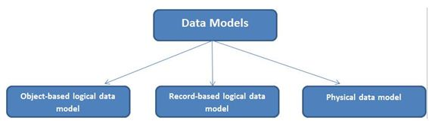
Data models
Data model is a collection of conceptual tools for describing data, data relationships and
constraints.

Slide 12
Advantages of Object Based data model :
Enriched Modeling Capabilities.
Extensibility and support for schema evolution.
Support long duration transactions.
Applicable for advanced database transaction.
Disadvantages of Object Based data model :
Lack of universal data model, experience, support for views and security.
Complexity is so high.
E-R Model is one type of Object Based data model.

Slide 13
Record-Based logical data model:
It has three types and those are follows –
Hierarchical Model (Ex: IMS)
Network Model (Ex: IDMS)
Relational model (Ex: DB2)
Advantages of Hierarchical data model :
It is simple, straight forward and natural method of implementing record relationships.
It is useful when there is some hierarchical character in the database.
Disdvantages of Hierarchical data model :
It cannot represent all the relationships that occur in the real world.
Insertion, deletion and updation anomaly are very problematic.

Slide 14
Network Data Model :
Problems of Hierarchical data model can be reduced by Network Data Model.
Advantages of Network data model :
It is useful for representing such records that have many-to-many relationships. Searching a record is easy for multiple paths.
Problem of inconsistency does not exist in network model because a data element is physically located at just one place.
Disadvantages of Network data model :
All the records are maintained using pointers and hence the whole database structure becomes very complex.
Insertion, deletion and updation of any record would require pointer adjustment.

Slide 15
Relational Data Model :
Problems of Network data model can be reduced by Relational Data Model.
Advantages of Relational data model :
It is efficiently used even with a personal computer that has limited main memory and processing ability.
It is much easier to use.
Relational database is very effective for small database.
Record relationships are implemented using primary keys and foreign keys.
Relational database is only connected with data and not only with structures, that improves performance.
It is very useful for representing most of the real world objects and the relationships among them.

Slide 16
Physical Data Models :
Physical data model represents how the model will be built in the database.
A physical database model shows all table structures, including column name, column data type, column constraints, primary key, foreign key, and relationships between tables.
Example of Physical Data Models are -
B tree
B+ tree.

Slide 17
COMPARATIVE STUDY OF NETWORK,RELATIONAL AND HIERARCHICAL MODELS
RELATIONAL | HIERARCHICAL | NETWORK
NEWER,MOST FLEXIBLE | ANCESTOR OF THE RELATIONAL AND ER | OLDEST AND LEAST FLEXIBLE
STRUCTURES RECORDS ON TABLES | STRUCTURES ON TREES.HAS PARENTS AND MULTIPLE CHILDREN CHILD AND | CONTAINS RECORDS OF INTERCONNECTED FIELDS
ALL POSSIBLE CARDINALITIES | ONE TO MANY | MANY TO MANY
BASE ON SET THEROY AND PREDICATE LOGIC | STRUCTURING TREE LOGIC | NO SUCH MATHEMETICAL LOGIC

Slide 18
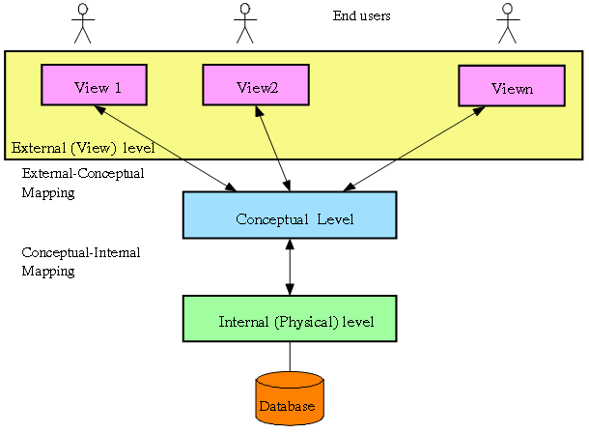
Three tier/level/schema Architecture or
ANSI Sparc Architecture :
The three levels are following -
1) View Level – The highest level of abstraction describes only part of entire database.
Ex: Tables, Fields, Keys.
2) Conceptual Level – The next higher level of abstraction, describes what data are stored in database and what relationship among those data. Ex : Permission, User control, Security, DB tuning Constraints.
2) Physical Level – The lowest level of abstraction describes how data are stored.
Ex: Data Structure,Algorithm, network, memory addresses

Slide 19
Data Independence :
Data Independence means that “ the application is independent of the storage structure & access strategy of data”.
Data Independence is the ability to modify the schema definition in one level should not affect the schema definition in the higher level.
Two types of data Independence –
Physical Data Independence : Modification in physical level should not affect the logical level.
Logical Data Independence : Modification in logical level should not affect the view level.
It is more difficult to achieve.

Slide 20


